Slide 1
Financial Reform and Development Banks
Dr Mark McGovern
Visiting Fellow
Economics and Finance, Queensland University of Technology
A presentation to the Brisbane Community Forum
May 28th 2019 at Upper Mt Gravatt Bowls Club

Slide 2
Crowded out –then forced out- by
“too much of the Wrong Sort of Debt”
– even if you owe nothing?
Welcome to our world!
“With very few exceptions the banks’ primary business consisted of non-mortgage lending to companies in 1928 and 1970. In 2007 banks in most countries had turned primarily into real estate lenders….” Jorda et al (2013)
“But the increasing importance of real estate and of lending against it has huge implications for financial and macroeconomic instability… Only when credit is used to finance useful new capital investment does it generate the additional income flows required to make the debt certainly sustainable” (Turner 2016)
Servicing a debt overhang can crowd out normal consumption expenditures, depressing effective demand and economies.
In the absence of effective intervention, ruinous downward spirals can develop. Needless destruction of key capacities, capitals and wealth follow.

Slide 3
Aspirations not well met…
Addressing the end of our debt dreamtime
For too many, these are days
of dashed aspirations,
of rising debts,
And of needless destruction of key capacities and wealth

Slide 4
Aspirations?
“Most parents only want three things” said Kev, in a country school playground over half a lifetime ago, “reasonable work, a good education for the kids and a decent place to live.”
  Do such aspirations resonate today?
  How do you think we are travelling?
  How would you express your aspirations?
Solutions to problems of “access”, “opportunity” and “belonging” are implicit in Kev’s comment

Slide 5
Aspiring,
We all journey in hope, along a long and winding road
Concerns of the
‘neglected classes’
Such you may think are life and living… but they are not the substance of today’s public discourses.
“Life and living” are largely ignored.
  Analysis and models in terms of ephemeral beings predictably responding in a determinable world that lacks depth, uncertainty and any need for judgement of events or evaluation of impacts dominate.
Thinking is fragmented.
  Economics today proceeds by ignoring finance, and vice versa.
  Finance today proceeds by ignoring life and living, and development.
When ungrounded finance rules,
aspirations go unrealized, and unrealizable.

Slide 6
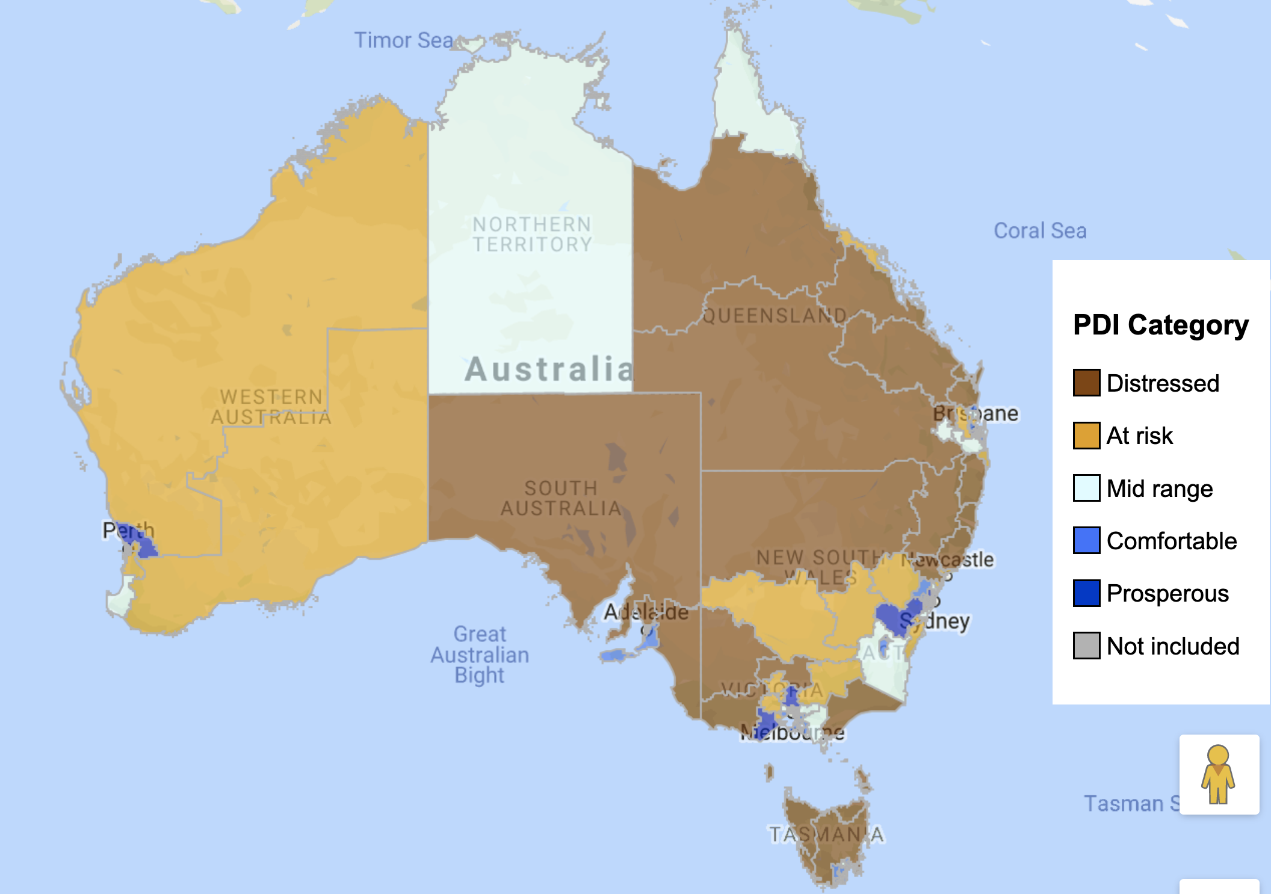
Frustrated, we all journey in fear, along an increasingly depressing and dangerous road.
Index of Prosperity and Distress (PDI)
Seven indicators are used:
No post school qualification
Change in housing vacancy rate
3. Adults not working
4. Poverty rate
5. Median income ratio
6. Change in employment
7. Change in business establishments
Baum, Mitchell and Flanagan (2019)
Baum et al
Note: each category includes 20% of “electorate” areas. Stress is uneven within areas.
Distress is pervasive and spreading yet foundational risks go unaddressed
Q: How might financial stresses relate to Indicators used in this Index?

Slide 7
Achieving Aspirations: the roles of Economy, Finance and Money
In supporting attainment of the aspirations of Australians, what sensibly are the roles of
  Economy?
  eg jobs as attainable, and supportive of reasonable income over time
  eg investments as worthwhile, and supportive of reasonable earnings
  Finance?
  eg savings as rewarding, contributory and “safe”
  eg loans as affordable, non distortionary and adjudged serviceable
  Money?
  eg purchasing power of AUD for consumption, home ownership and external purposes
Multiple failures exist today
  Short-termism and the gig economy provide an unsustainable cost-return basis
  Much finance is not fit for purpose and
  Purchasing power is debased
How might we prudently renew roles to assist apt attainments?
Uber drivers’ experience highlights the dead-end job prospects facing more Australian workers

Slide 8
Since Kev spoke, a multi-decade “debt dreamtime” has lead to imbalances and financial crises across the planet
Along the way…
Numerous Parliamentary Inquiries
  Senate “Rural Adjustment, Rural Debt and Rural Reconstruction” Report 1994
  …
  Financial Services Royal Commission 2019 Report
Treasurer Initiatives
  Commonwealth Rural Debt Roundtable 2012, and ad hoc Working Group
  amongst other papers, “Rebuilding Australian (Rural) Finances” 2014 for discussion here
  Queensland Rural Debt Roundtable 2015, and Taskforce
  Queensland Rural Debt and Drought Taskforce Report 2017
Problems have deepened, especially of incomes and debts, and spread.
Yet, the delays, denials and deceits have been ridiculous. Why?

Slide 9
dangerous end of “debt dreamtime” underway yet stressed fundamentals go unaddressed.
PROSPECTS, as “Act 2” of the GFC Script builds to a climax
Australian enterprises and households face major falls in property values.
This will be exacerbated by property fire sales.
These will trigger non-monetary loan defaults.
As financial liquidity tightens,
  depressive economic conditions worsen
  as will continue needless destruction of wealth
  until apt policies are effectively in place.
TIMING ACROSS AUSTRALIA
Farm and town enterprises already well into a cycle which began around 2008. National farm debt is at around $70b with around $3b likely acute (a relatively easily manageable book).
Coastal and inland cities followed after around 2012.
Major urban areas began around 2015 with major deterioration clearly evident in 2018 (in a very large loan book).
GFC
DESTRUCTIVE DEBT DEFLATION
destructive asset-deflation spreading

Slide 10
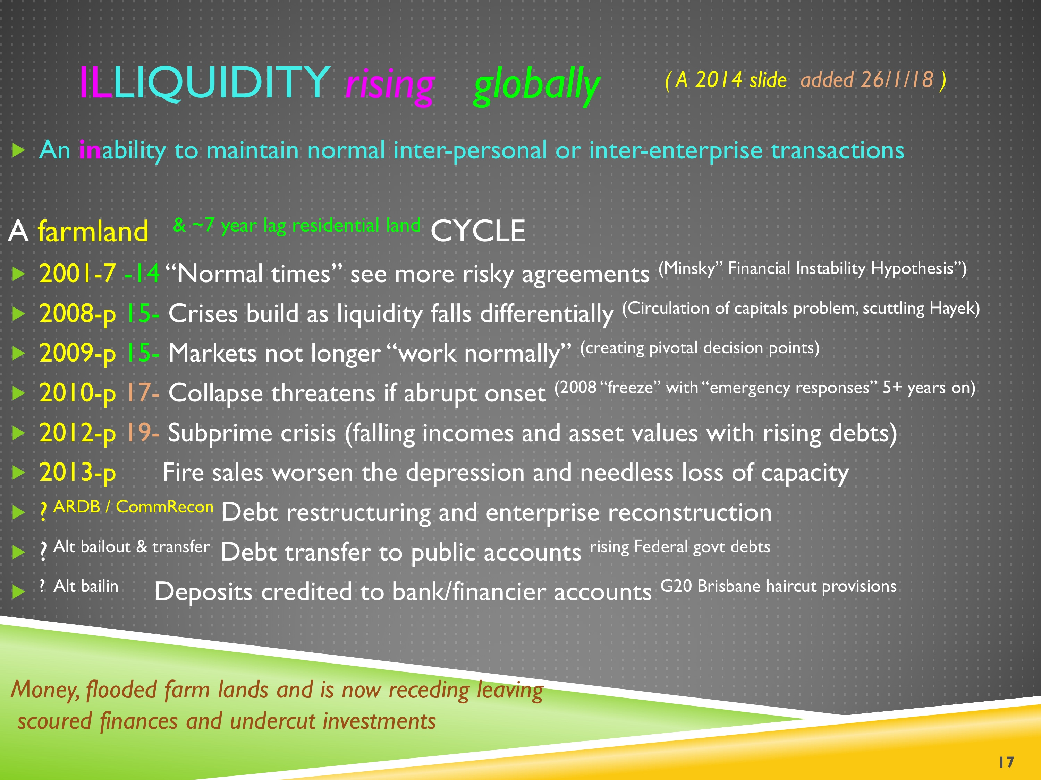
Same
DESTRUCTIVE DEBT DEFLATION
Cycle
Major Urban lagging
Rural Aust by
~7 years?
RURAL MALAISE and increasingly now larger urban
Publicly presented to Ministers, media and advisers 2014 twice – but no interest evident

Slide 11

$−50\% ∓30\%$
Asset deflation in financial crises
Overseas and regional Australian experiences indicate 50% Average Fall from Peak asset prices
Larger, longer fall sustained if poor policies – and apt policies do make a difference!
Apt policies can moderate both falls and duration.
Size of Falls will vary by area, past financing and market history, so 30% variations either way.
Major Urban residential is particularly exposed.
  UBS estimates around one third of the value of residential mortgages booked at $500b are in “liar loans”
  BUT if such loans are based on lies, by lender or borrower, why should they continue “uncorrected” or at all?
Need policies to reduce overly depressive effects on asset prices and economic conditions
But time is running out.
Fortunately analysis of rural experiences provide a path to sound policy options.
So, let’s step back 5 years…

Slide 12
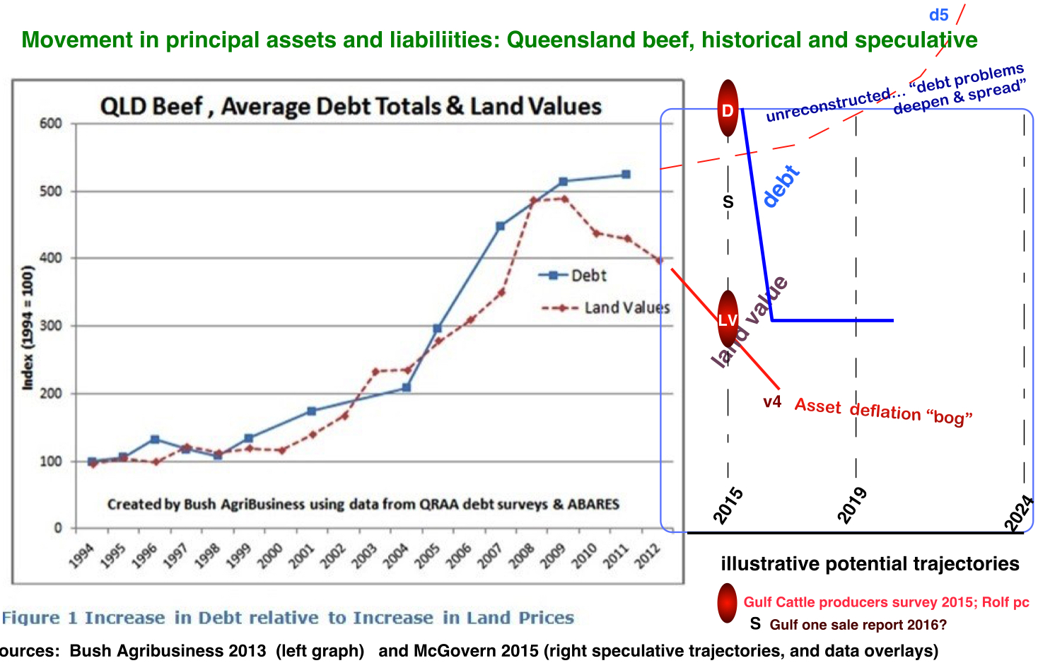
Qld Beef - and ^{lagging 7 years} Capital City households?

Slide 13
Just sitting back is no longer an option…
Rebuilding Australian (Rural) Finances
Seminar Paper, March 2014 (copies on request)
provide context, background thinking and lines of argument

Slide 14
A discussion draft canvassing aspects of core economic and financial imbalances
Structure
Messages
Overview
On the Implausibility of being Right for 40 years
The “Thinks that Matter”
Curiosities and Central Banks
Dealing with Subprime Agriculture
1. Apt policies needed for new challenging times
2. Policies that incubated problems will not solve them.
3. We need a more grounded perspective to engage the world, and each other.
4. Banking and Finance need to better meet recognisable realities
5. An extraordinary cycle underway and distinctive policy responses are needed.
Australia’s situation is not as dire as in many other nations - yet.
Problems can be well addressed if we so choose and aptlyrespond.

Slide 15
Needs Evident ^{in 2014}
(2014) Page 16 Four specific R&D needs are to outline potential:
alternative financial arrangements to the existing farmer-banker mortgage which involves “impatient” interest and no longer any interest rate subsidies that previously served as a sectoral safety net. Suggestions on using project development funding arrangements have met with some good interest;
effective organisational relationships. These potentially involve the RBA appointing specialist agents and engaging non-traditional funders (such as superannuation funds, joint venture partners, potentially from overseas, or its own resources) or revamped banking arrangements. As important will be better funding practices (and I note the ACCC interest in behavioural economics as an aspect worth exploring);
development bank objectives and orientations. The legislation as currently drafted specifies “Agriculture and associated industries” in a development context. This mirrors the need for long term, patient and perhaps concessional finance for investments that are in the national interest. A related question is apt strategies for the recapitalisation of an industry in an open economy; and
reconstruction processes and objectives. This is potentially both interesting and contentious as the sectoral de-risking effects of helping “contagious” high-risk others appears little understood. The prospect of reducing interest rates (by reducing the sectoral premium) is understood but there are wider issues.

Slide 16
Essentially
Correcting market excesses and failures
Alternative financial arrangements
  Products fit for purpose
More effective… (E5) organizational arrangements
  Institutional capacity building
Development bank establishment
  Funding basis for neglected national and industry capacities
Debt Reconstruction
  Dealing with unsustainable arrangements and the debt overhang
The ARDB Bill (2013) was drafted to establish a key component in such a correction, and not just for rural regions but any suffering similarly… It still provides a most effective option.

Slide 17
Much has happened since 2014, but constructive dialogues and actions have not - so problems have worsened.
Points made in 2014 remain relevant, and foundational.
Ongoing research outcomes, including already from the Royal Commission, which can help rapidly consolidate a well-informed agenda, and needed policy stances
Findings in Notable books
Eg One of five required sets of policies … “Actions to ensure there is enough credit to fund required capital investment, for instance through the creation of banks with a dedicated focus on specific lending characteristics”
  Turner, A. (2016). Betweem Debt and the Devil: Money, Credit and Fixing Global Finance. New Jersey, Princeton University Press. Ch 13.
Rising public disquiet in Australia – as well as evident financial organisation stresses and institutional discomfort and lately evident unease
Debts worsen … when will we be awoken from our dreamtime?

Slide 18
Re-basing our actions
Blindly continuing with ideas and conventions that incubated problems and crises is foolhardy, and needlessly destructive of key capacities and wealth
The conceptual basis for prudent E5 actions for today’s problems is available in till-now little used literatures of economic and finance.
Foundational problems require foundational changes.
Government bailouts, depositor bail ins, speculative bail ups and like transfer arrangements only spread problems.
Financial system responsibility and prudent investment prospects are central.
Relevant details must here be left to another place …
Rebuilding viability and vitality require more than superficial tinkering

Slide 19
Addressing imbalances
Mitigating crises
Rebuilding Australian finances
- and again prudently realising sound Aspirations
AGENDA
A stimulus... ponder, talk, argue, research, agree and act

Slide 20
Issues, and Impacts on Parties to the Financial Relationship under Stress
Damaging
Restorative
Denial
Overlooking key contributing factors
“All your fault” attributions for failures
Secrecy
‘Letter of the law’ contract dealings
Entitlement of Banker “rights”
A private interest dominates
Asymmetries unchallenged
And more….
Honesty
Recognition of factors beyond control of parties
Shared responsibilities for rectifications
Transparency
‘Spirit of justice’ contract resetting
Due Recognition of all party interests
Public interest accommodated
Power and other imbalances recognised
And others…
Need
E5 actions “that help us ‘deal well’ with each other”

Slide 21
Underlying Issues of allocations and effects – and how these are, and might be, managed?
Siting Situations
Underpinning dynamic
Economy
  Incomes and Expenditures
Finances
  Savings and Debts
People
  Contributions and Drawings
as/after engaging eg physically active
  Employment of Factors
as accounted eg in balance sheets
  Returns and Costs ^{incl servicing Debt overhang}
as grouped eg in families and communities
  Needs as met by formal (eg “paid”) and informal means
Some such schema is one starting point for policy evaluation and renewal - after we first determine policy objectives which brings us to banking reform

Slide 22
Some Areas for Action
A basis for sustainable finance and regenerating prudent investments
Area
Need, and an option
Government debt
Rural income
Mortgage debt stress (rural or urban)
Property investment
Societal base investment
Specialist investment
Banking system
Bank management
Unfit-for-purpose finance
and …
reduce interest rate and broaden base via direct issue eg Qld
stabilise base income via environmental stewardship initiative
1 avoid fire sales and destructive disorderly workout via reconstruction (modest to major)
2 central bank revolving facility expediting process
viable key ratios via facilitative market management
Public development bank
Industry development bank
Destress balance sheets via prudent rebasing
E5 relationship capability via subsidiarity and transparency
Revamp product lines and investment relationships
by …

Slide 23
E5 solutions effective, equitable, efficient, ethical, enabling
No time like the present for action?
Which Cases that need E5 actions will you help address?

Slide 24
beyond “beam me up Scotty” (or “Shortenly”) financial teleportation thinking
Scott Morrison launches Coalition campaign six days out from federal election
  "One of the new announcements in today's launch was the Coalition's commitment to helping first home buyers save for a deposit sooner by lowering the required deposit from about 20 per cent to 5 per cent.
  Currently, if a prospective home owner cannot raise the industry-standard deposit, banks require them to take out mortgage insurance.
  Under this scheme, eligible first home buyers would not have to pay mortgage insurance and instead, the Government would guarantee the difference between that lower deposit (down to 5 per cent) and the industry standard (about 20 per cent).
  The full details of the scheme have not yet been released, but Mr Morrison said it was aimed at allowing people to get onto the property ladder sooner.
  "It's hard to save for a deposit. Especially with the banks pulling back and larger deposits of 20 per cent now being standard. It is not getting easier," he said.
Economists warn Coalition's first home buyer deposit scheme is 'irrelevant' and 'ineffective’
  The added risk of buying in a slowing market
  JP Morgan chief economist Sally Auld said encouraging first home buyers to enter the market in a period of uncertainty could mean some of them might end up owing more than their property is worth — something known as negative equity.
  "In a market where at the moment house prices are still continuing to fall and the sort of one to two-year outlook is reasonably uncertain, I'm not sure that encouraging a cohort of buyers without an established credit history to take out loans at a high loan-to-value (LVR) is sort of hugely sensible."
  "I mean, the point with this is that the money ultimately has to be paid back," Ms Auld said.
Policy initiatives need well-informed analysis and prudent development
– along with acceptance of current realities

Slide 25
Challenge
What is your preferred financial and economic position for 2020, and after?
What appears to be likely if nothing is done?
What will be your responses?
Which “Area for Action” most interests you?

Slide 26
Rebalancing: 7 principles
Government is not a bank, and should not use its balance sheet to act like one.
The Reserve Bank of Australia is a public bank with apt but neglected Charter responsibilities.
Development which requires long term patient finance is the core business of development banks.
Loan destressing and reconstruction are part of balance sheet rectification.
Orderly workouts are better than panic, hubris and fire sales.
Policies that incubate problems will not solve them.
Transparency, mutuality and subsidiarity aid robust inclusive evaluations and successful investment.
Financial crises are complex but skilled interventions can make a real difference.

Slide 27
Happily, the RBA is unique in its Charter responsibilities, position and potentials
WISELY in the RBA Act (1959) ^{Emphasis added}
  “It is the duty of the Reserve Bank Board, within the limits of its powers, to ensure that the monetary and banking policy of the Bank is directed to the greatest advantage of the people of Australia and that the powers of the Bank … are exercised in such a manner as, in the opinion of the Reserve Bank Board, will best contribute to:
  the stability of the currency of Australia;
  the maintenance of full employment in Australia; and
  the economic prosperity and welfare of the people of Australia.
UNFORTUNATELY this was very narrowly interpreted:
  “Policies in pursuit of these objectives have found practical expression in a flexible, medium-term inflation target, which has formed the basis of Australia's monetary policy framework since the early 1990s. The policy objective is to keep consumer price inflation between 2 and 3 per cent, on average, over the business cycle. Monetary policy aims to achieve this over the medium term as a crucial precondition for the promotion of sustainable economic growth and employment.
  “The sixth Statement on the Conduct of Monetary Policy, signed by the Treasurer and the Governor in October 2013 following the election of the Coalition Government records the common understanding of the Government and the Reserve Bank on key aspects of the monetary policy framework.” (RBA 2015 Report)
TODAY duty, expression and understanding all need renewal. Neglect of its banking duty allowed unprecedented asset inflation. Inflation moved, it was never “conquered” (Cornish 2018).
3 Fails?

Slide 28
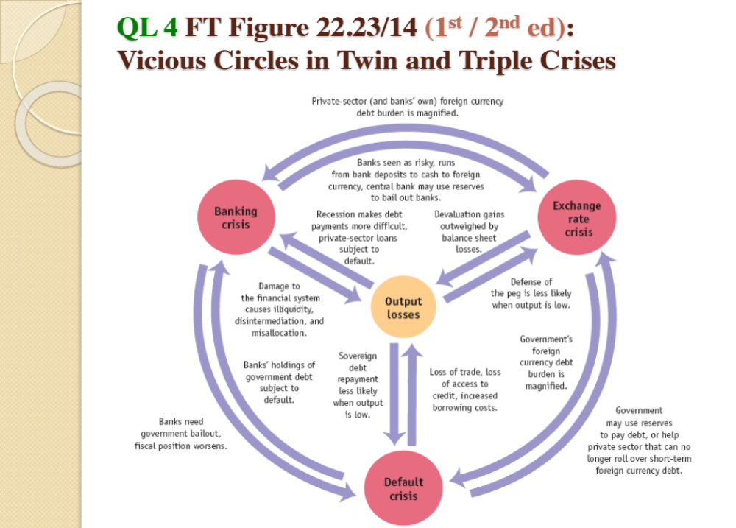
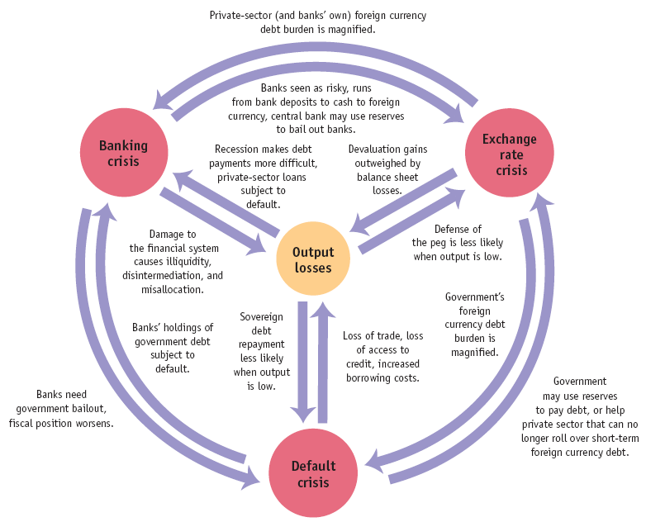
QL 4 FT Figure 22.23/14 (1st / 2nd ed):
Vicious Circles in Twin and Triple Crises
The Conundrums we all face,
and Opportunities…
if we learn from experiences
and build apt actions
“Quick Lesson 4" Slide 13 Lecture 1 using Feenstra and Taylor “International Economics” building on Bank of England

Slide 29
To be continued…
Some further analysis in
  Baum, Scott, William Mitchell, and Michael Flanagan. 2019. “Prosperity and Distress in Australia ’s Cities and Regions.” (May). http://www.fullemployment.net/pdi/maps/Aus-PDI-map-2016.html.
  Cornish, Selwyn. 2018. The Evolution of Inflation Targetting In Australia. Canberra.
  Katter R (Chairman). 2016. “Addressing Debt and Drought Problems in Rural Queensland.” https://www.daf.qld.gov.au/ruraldebttaskforce/final-report
  McGovern , M. (2011). "Beyond the Australian debt dreamtime: Recognising imbalances." Economic Analysis and Policy 41(3): 169-191 as well as related papers at ruraloz.net
  McGovern, M. (2014). "Subprime agriculture, and Australia?" Economic Analysis and Policy 44(3): 243-258.
  McGovern, M. (2017) The Queensland government is paying more for its debt than the average mortgage holder https://theconversation.com/the-queensland-government-is-paying-more-for-its-debt-than-the-average-mortgage-holder-87586
  Royal Commission papers (useful case studies but failure to appreciate systemic problems)
  Turner, Adair (2016). Between Debt and the Devil: Money, Credit and Fixing Global Finance. New Jersey, Princeton University Press
  Web pieces (eg Conversation, ABC News) are available by pressing immediate phrase to activate hyperlink

Slide 30
Your thoughts?

