Slide 1
revitalising
Rural
Australia
ARDB as a key response to a deep seated structural problem
Mark McGovern
Economics and Finance QUT
Paper presented to the Rural Crisis Meeting, St George Feb 1 2014

Slide 2
MY Position ^{One open for engagement…}
Drought impacts do need urgent attention – but foundational problems lie deeper
Australian Agriculture is operating on an unsustainable basis.
Current debt stresses are the logical outcome of
  decades of unbalanced markets,
  inappropriate finance, which the ARDB would help address
  untoward practices and
  inept policies.
leading to a deep seated structural problem
All four need to be rectified if we are to address the problem and revitalise rural, and urban, Australia.

Slide 3
REFLECTION
Yesterday
Today
Tomorrow
The day after
All my troubles seemed so far away
At a critical juncture in many a life’s journey

Slide 4
How have you been travelling for the last 40 years?
A big question with all manner of interactions and events providing the many individual answers…
You have much to be rightly proud of, but today we all face serious “unexpected problems”
Today is about ways we might work to address “challenges”, and nurture hope and future prosperity.

Slide 5

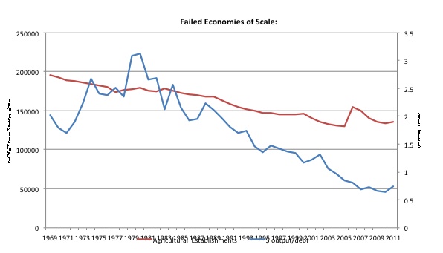
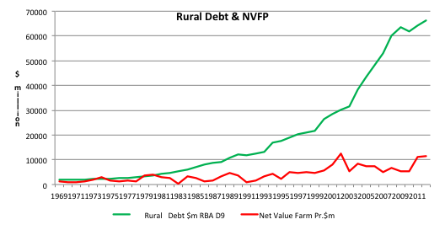
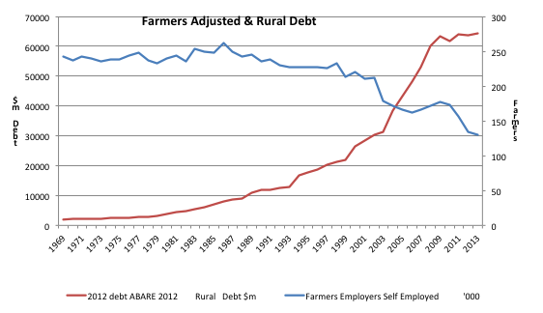
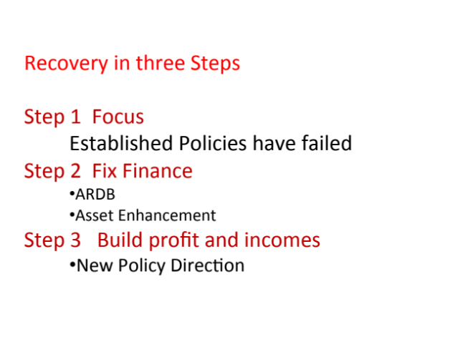
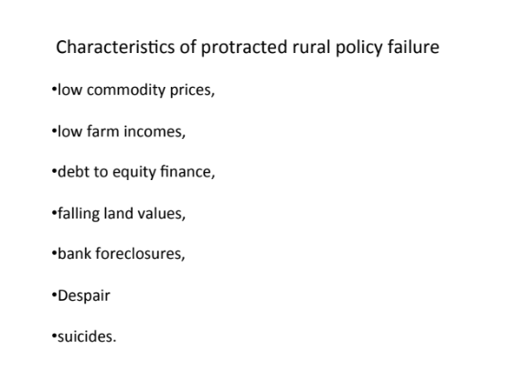
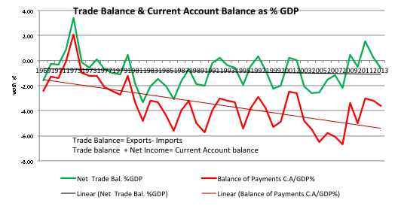
Ben’s PAGE ^{& his best wishes} benrees.com.au

Slide 6
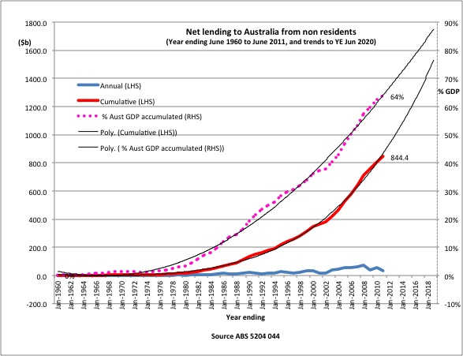
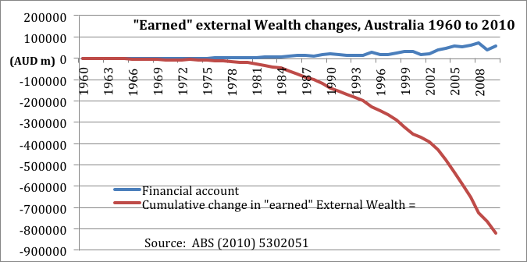
…and what of Australia?
External earnings and wealth
Foreign Debt
Annual shortfalls accumulate
So we borrow more and more
Annual borrowing
Total External Obligations
GNE > GDP > GNI
National expenditures exceed incomes

Slide 7
40 years of A nation going backwards, badly
“All the efforts of a generation of Australian men and women have only made them more indebted to the rest of the world. We stride the world stage with debts above seventy percent of GDP, and increasing. Unaddressed, this is a precursor for crisis...”
Debt Dreamtime McGovern 2011 and Barnaby is right
Agriculture is one of the few sectors that might turn this trend around – but it can’t in its present condition

Slide 8
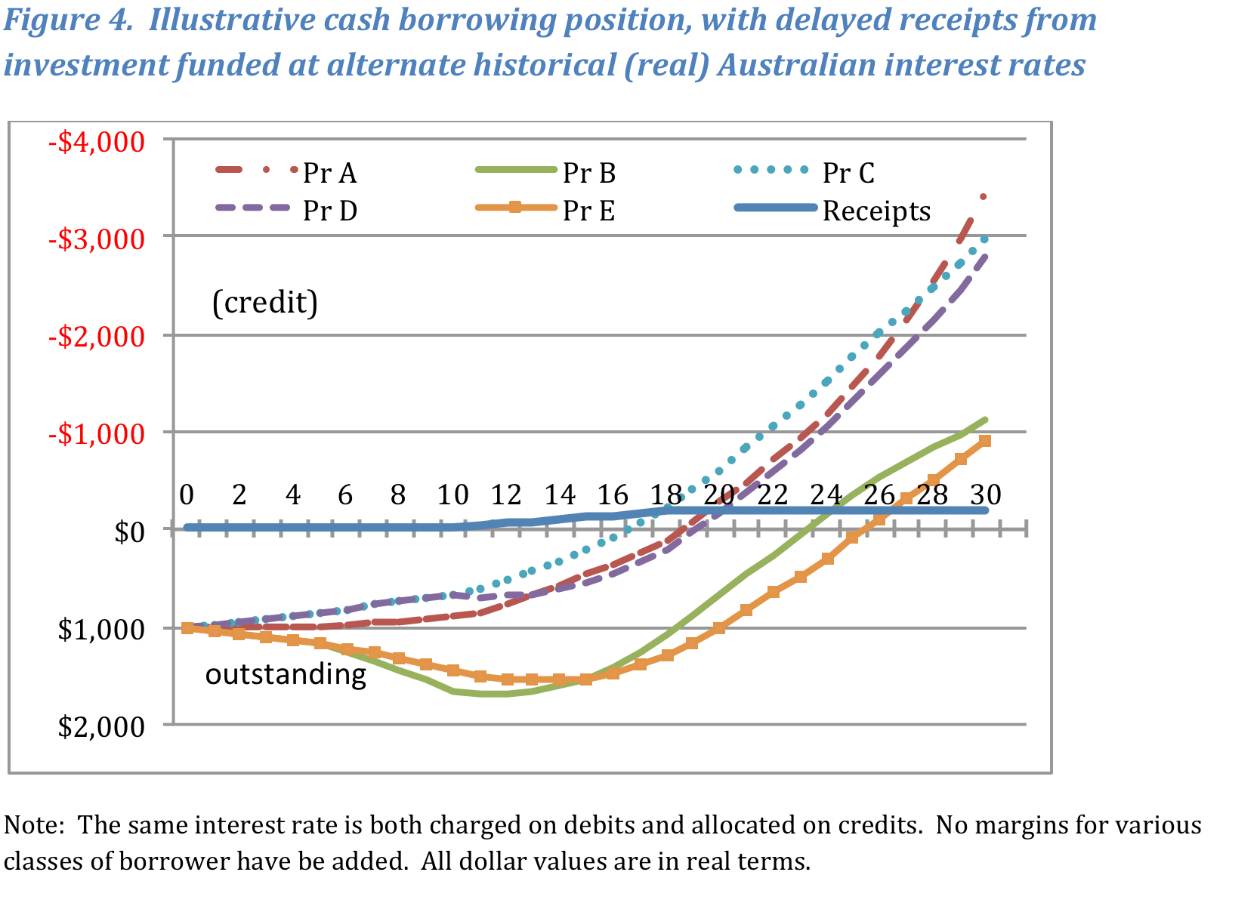
…And It’s Not Just Ag but all Debt-funded investments
McGovern “On Unaffordable regional infrastructure” 2011
Notes:
Cohort A C D commencement years were 1905, 1940 and 1970
Cohort B commenced in 1925 and was affected by years of depression and war.
Cohort E which commenced in 1980 and completes during this year was affected by years of growth and modern monetary policies.

Slide 9
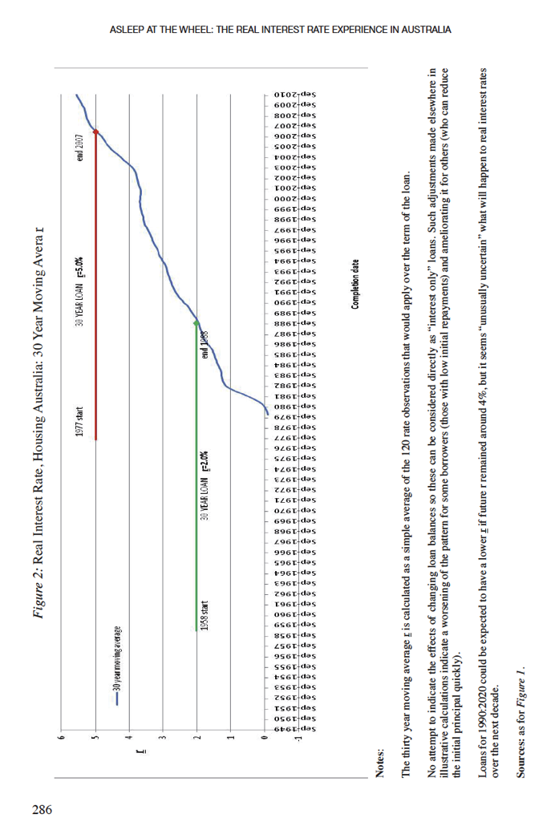
REAL INTEREST RATES 30 yr simple average
AND
Just where now?
$A
$US
€
¥
£
And headed where?
Crises reset interest rates strongly down but…
McGovern 2010

Slide 10
If you used debt funding…
You and many others never really stood much of a chance
And now you and “Australian” organisations are deep in debt, a proportion of which was never serviceable from the start…
Systemic and routine failures to assess adequacy of income to service loan
…and remember other funding means also failed .
Agriculture is particularly exposed due to volatile incomes while food is regularly dumped (as we would expect from modern trade theory).

Slide 11
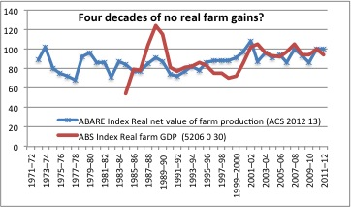
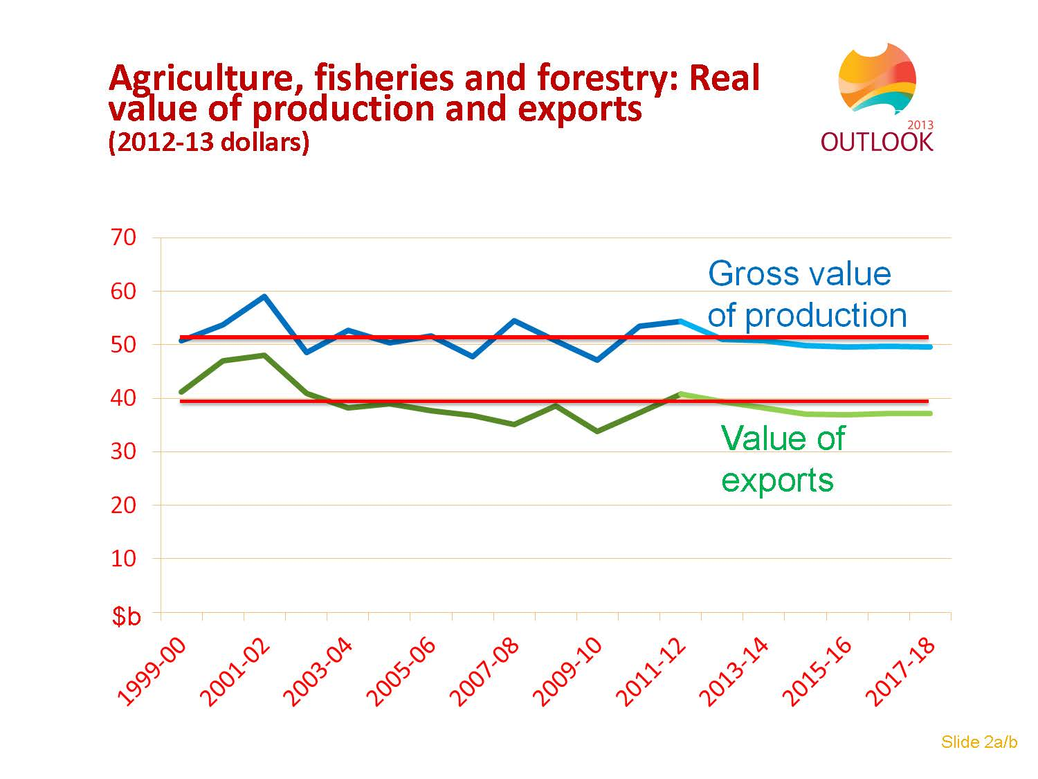
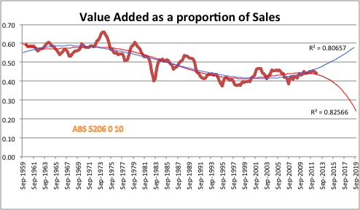
40 years of an Industry going nowhere much
Fewer farms and farmers but no real industry gains
Rationalisation is empirically a failed strategy
Liberalisation has not delivered
And an uncertain future
Two “equally likely” trends
The past offers no clear guide to the future
The future will be what we, each and all, make of it

Slide 12
Such conditions typically lead to Financial CRISES
An inability to meet commitments due to imbalances, financial and other
Individual
Systemic
Scattered problems
Able to be resolved routinely
Some enterprises with balance sheet stress
Normal business cycle variations
Case by case treatment enough
Key variables little influenced
  Normal cyclical variations
“Green zone” operation sufficient
Liquidity not an issue
Pervasive problems
Resolution requires system changes
Sectors with many unworkable balance sheets
Spiral down until arrested
Contagion induces multiple crises
Major resetting of key variables
  Interest rates plummet, to no effect
“Extraordinary” operations needed
Liquidity a central problem

Slide 13
REFLECTION
Yesterday
Today
Tomorrow
The day after
How many times must a man turn his head,
And pretend he just doesn’t see
DENIAL
and CONFUSION
At a critical juncture in many a career pathway

Slide 14
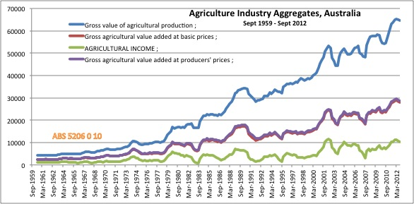
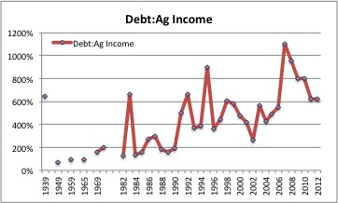
When you don’t retain enough
Retained income is the bottom line
Deeper into debt you go
And things are worse if your income fluctuates

Slide 15
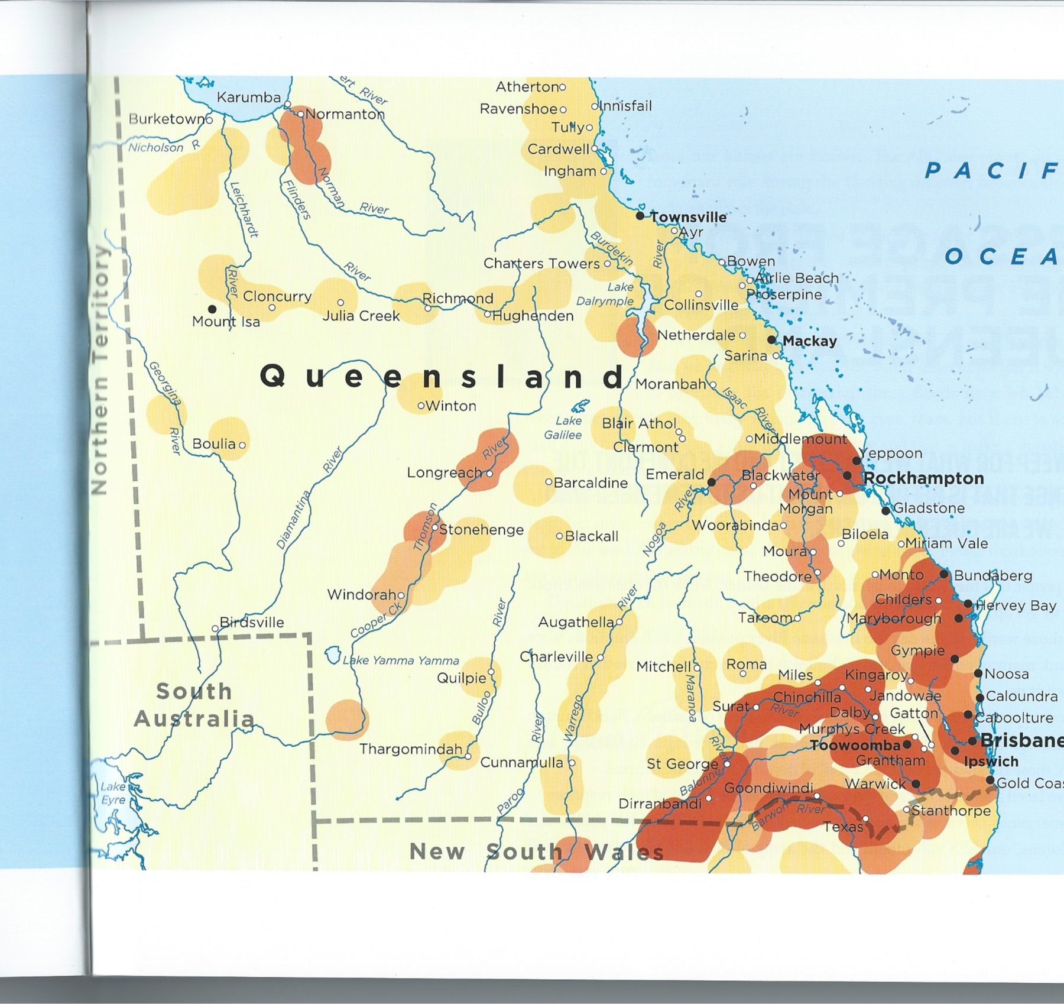
ILLiquidity rising globally
An inability to maintain normal inter-personal or inter-enterprise transactions
A CRISIS CYCLE
“Normal times” see more risky agreements (Minsky” Financial Instability Hypothesis”) ROOT 1
Crises build as liquidity falls differentially (Circulation of capitals problem, scuttling Hayek) ROOT 2
Markets not longer “work normally” (creating pivotal decision points)
Crises mature and become manifest in various areas before spreading apace
Collapse threatens if abrupt onset (2008 “freeze” with “emergency responses” 5+ years on)
We can be proud with how we deal with natural crises, but will the same be said about us in our dealings with the rural financial crisis? Many of the same lessons apply… and the dangers are also imminent and very real
Money, like water, flooded farm lands and is now receding leaving scoured finances and undercut investments

Slide 16
…and don’t wait for salvation by Foreign Investment
The Global Farmland Rush is receding, leaving disrupted land markets and opportunities only for predatory capital or strategic national entities.
Farmland risk rating is up globally:
  the [Federal Advisory] council warned the Fed in February 2013 as the ARDB would that, “Agricultural land prices are veering further from what makes sense . . Members believe the run-up in agriculture land prices is a bubble resulting from persistently low interest rates.”
  so the USA and others have already moved to shore up positions, including through the extensive open support available under the new Farm Bill
With easily available income support averaging ~20% elsewhere in the world, Aust farming is an uncompetitive investment strategy

Slide 17
The slowness of collective realisation and the persistence of embedded collective unintelligence
It often takes a while for something important and recognised by some to become well known and accepted.
This is especially true if some (fear they might) lose… for example
  Queensland sugar income split
  Soviet national accounts and the “unexpected collapse” of the USSR
  Barry Jones and Labour: the failure to hear, let alone wake
  “Relaxed and comfortable” Oz while farms and 100 000+ farmers were rationalised
  Treasury official discussing public debt when his personal exposure is worse
Changing the preferred answers to key questions can change the world

Slide 18
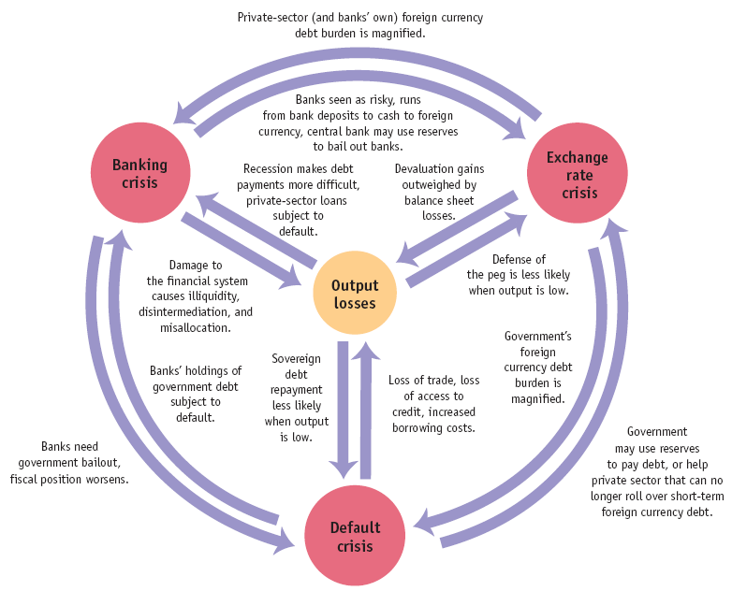
GFC Act 2 building to climax (-es) but the final script is not yet written
Experiences reflect different responses:
Argentina
  Capital loss and FDI flight, repetitive depression
  Stripping and ongoing external dependence
  External, macro and micro collapse
Russia
  Corporatist state with intolerance, confiscation and suppression
  Centralist Isolation and external distrust
  Macro cohesion, micro collapse and external stress
Poland
  Mutual effort, support and resolve
  Subsidiarity and common direction
  Macro collapse(SFC) now cohesion, micro cohesion, external engagement
Australia?
Expect Fracture in one or more links
Outcomes depend on what you/we do NEXT
FT Figure 22.23/14 (1st / 2nd ed):
Vicious circles in twin and triple crises

Slide 19
REFLECTION
Yesterday
Today
Tomorrow
The day after
Pubs with no beer, or cheer
Biting subprime Agriculture
or
INFORMED
RESOLVE
At a critical juncture in many a community journey

Slide 20
Aust Ag in the bigger scheme of things
Major sectoral subprime crisis (debt-deflation spiral underway)
Some contagion but currently still manageable
Relatively small “~$5b” problem in Aust Economy and Financial System
Long term decline in conditions need to be addressed for a profitable future
However, complex systems fail spectacularly so no problem of this type is ever “too small” or amenable to “market solutions”
  When serious systemic failures threaten “Normal Policies” have perverse outcomes
  Market outcomes need not be societally desirable, as in Samuelson’s 1949 comment about market equilibrium potentially at 50% unemployment and Leon Walras’ 1890s comments
  The old rhyme “For want of a nail… a kingdom was lost”
  Baumol’s “each division a profit centre” driven closure of an initially profitable enterprise

Slide 21
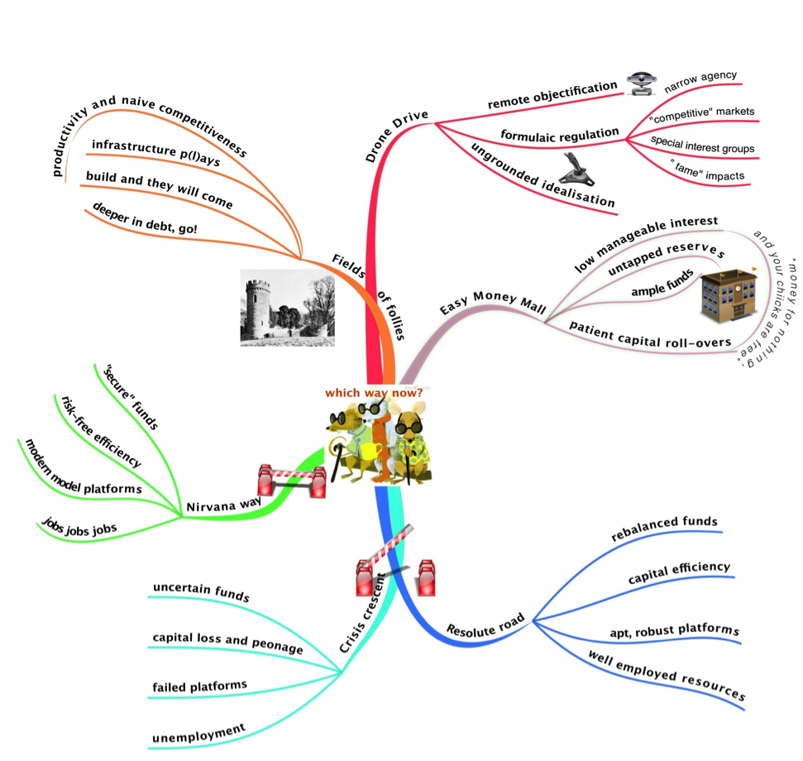
Imprudent investments
The basis of our problems?

Slide 22
PAPER (Muntadgin & Colac meetings April 2013)
Repositioning Rural Australia
Agenda
Argument
(Im-)Prudent Investment ⬅
The wash up…
The ways we are, empirically
Ways forward
Available at ruraloz.net
See also Ben’s papers at benrees.com.au

Slide 23
Aust Ag capital position rough summary estimate illustrative only
Land value | Debt | Farmer equity
$ 360b | ~“50%” debt free |  | “Debt free” can suffer asset value loss from contagion
If half land carries debt |  | Old equity | Need real bank INFORMATION
$180b | $60 b | 67%
30% asset write down |  | Current equity
$120 b | $60b | 50% | RISK RISING irrespective of on-farm successes
Further ~20+% fire sale write down |  | Potential 2015 | If you can find a buyer (suitable or not?) LIQUIDITY PROBLEM
$100b | $60b ++ | 40%

Slide 24
Illustrative Simple Scenario of “Farmer A” ARDB Stabilisation Avoiding “fire sale” Step 6 reducing capital and capacity losses
Farmer A with no debt and initial $5m property borrowed for a neighbouring block at inflated land prices… which then fall
Successfully operated to meet interest due and costs each year.
But land markets changed around him so his equity fell
Fire sale would leave both worse off by $1.3m compared to stabilisation
  Fire sale $10.0m realised (including interest) as against $11.3m with stabilisation
  To be split between bank and farmer
Split needs to be determined
An entering farmer’s ability to pay a serviceable land price is inversely related to the interest rate charged
Obviously much more adequate analysis is needed but possibilities for enhanced outcomes can be explored

Slide 25
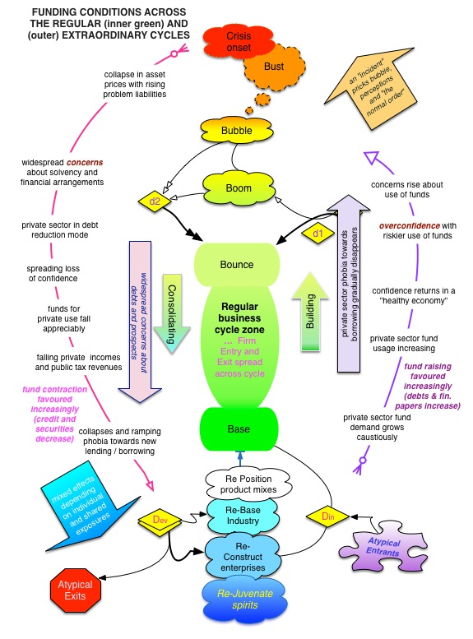
Developing more prudent investments
Taming the extraordinary cycle as the highest priority STABILISATION
Reconstructing enterprises and positions RECONSTRUCTION
Providing liquidity to important capitals DEVELOPMENT
Committing to realistic industry strategies PROFIT
Renewing hope, grounding prospects and achieving potentials REJUVENATION
Adequate returns to capitals…
the basis of our solutions!

Slide 26
ARDB: a board within the RBA
A central body with a responsibility and ability to help deliver on such things – directly and via agencies, exemplars and well-informed markets
Draws on existing powers of the RBA
Receives real title to physical properties in exchange for any credit provided at written down values
Financial problems are to be solved (& avoided) primarily within the financial system
Initiates and may offer a variety of financial arrangements as needed
Should draw on past successes, existing capacities and well-considered innovations
A capable entity in own right that should not normally engage with government budgets
Under the oversight of the Australian Parliament and the main RBA Board
With active and insightful engagement with industries and enterprises.
See briefing notes and Bill preamble

Slide 27
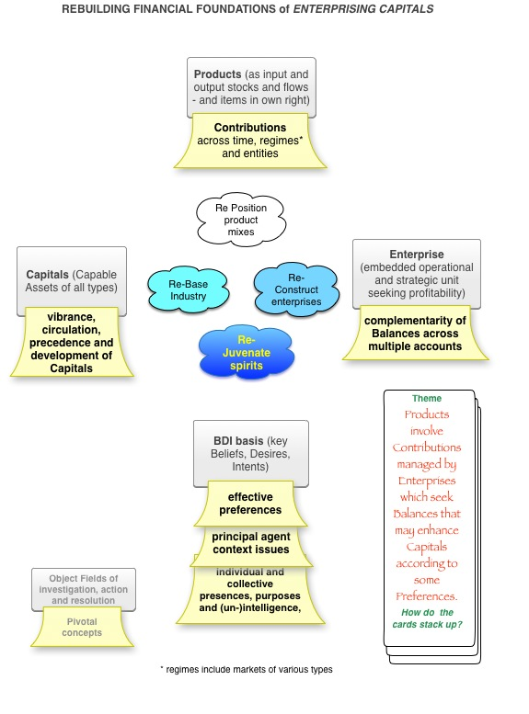
REFOCUSSING:
Enterprising capitals
Changing emphasis
FROM top “Products” as singularly focal (Current)
TO interlinked centre with focus on results achievable, and achieved by enterprise and capitals
From models that assume supply to models that examine capacities over events and times – things that were once “important”.
So addressing deep structural issues

Slide 28
REFLECTION
Yesterday
Today
Tomorrow
The day after
Australians all let us rejoice…
At a critical juncture in the nation’s journey

Slide 29
GOLDEN RULES in any economy, viable society and nation
Enterprises that are profitable have a future.
  A rule ignored?
  With history and maths forgotten?
Incomes must sustain factors and replenish capitals over time, place and effective groupings
  Historically, accommodations for a “decent standard of living”
  Need new accommodations and a move beyond simplistic thinking
Balances must be cast ^{(ALS)} equitably
  Traditionally, the Australian “Fair Go”
  Lately “is it anything goes?” in our diminished national capacity
Act with immediacy when needs are pressing
  As in current drought and capital run down crises

Slide 30
An enterprising economy, society and nation
True gold
Fools gold…
Commitments to profitable, sustained, effective and equitable achievements with robust capitals@ times, places and persons
  Mutual advances
Unprofitable, unsustainable inequitable and exclusive opportunism (as in the competitive market speculation of casino economies)
    Beggar thy neighbour
1
2
3

Slide 31
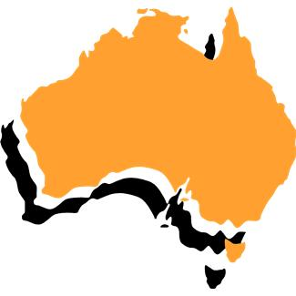
Building a basis of ongoing prosperity
SEEK: Profitable enterprise as a means to…
Purpose
Predispositions
Processes
Common resolve
Viable activities
Affordable funding
Progressive relations
Prudent conduct
Equitable regard
Realistic positioning
“thinking that E3 works...”
Apt orientation
Adequate Factor incomes
Build Own Operate & Develop
ENHANCED
CAPITALS
Base country

Slide 32
After 40 years
IT’S TIME…
to move beyond the Whitlam put
The world has changed but underlying thinking and policies have not adapted. Result is unaddressed deep structural problems impoverishing Australians and Australia.
The ARDB is a separate administrative and financial unit, one not reliant upon the government budget, that properly constituted could competently do much to “improve the wellbeing and prosperity of Australia and Australians” in town, country and city.
Thank you SWQ!
Copies at ruraloz.net
m.mcgovern@qut.edu.au
Questions?

Slide 33
AN addendum
On a current policy issue

Slide 34
Predispositions
Enterprise Orientations “around the shared table(s)”
One Nation Enterprises ONEs
Multi National Enterprises MNEs
Confined to a single nation
  Factor mix confined
  Products
  Returns, consistently accounted
  Citizens
  Intra-national arbitrage as owned and operated “locally”
  Single encompassing jurisdiction
  Internal national competition
  “Each” may be a domestic champion.
Spread across several nations
  Factor mixes “smorgasbords”
  Product distributions
  Multiply Accounted Returns (alt currencies)
  Stakeholders
  Intra-organisational and Inter-national arbitrage (trading for advantage)
  Many competing jurisdictions
  Multiple national competitions
  Each nation may promote its champion(s) internally and externally
Choice sets and potential impact distributions vary significantly between MNEs and ONEs

Slide 35
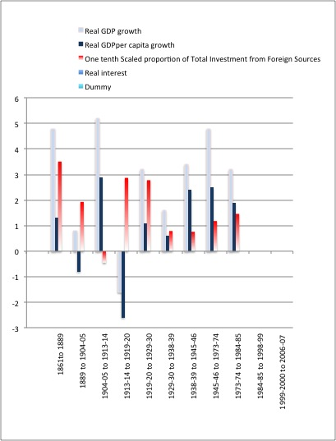
“We depend on FDI” and other errors that foster a reliance upon other people’s capital…
Australia 1861 to 1984
Work in Progress but …
no clear relation between FDI and GDP growth
Obviously the quality of the investment and its interrelations with the Aust economy matter.
Compare Black with Red …
Real GDP per capita with Foreign Investment indicator

Slide 36
^{Financial} Capital dynamics ^{briefly}
Capital formation is the key step in a viable capitalist economy
This appears poorly understood by current “Wizards of Oz” but not by others elsewhere.
Domestically, capital formation is made difficult by interest, tax and like arrangements
Externally, in terms of the Balance of payments there are four significant components that definitionally sum to zero
  Current Oz today
    Merchandise trade ~ -$A 5b net as imports exceed exports (M > X persistently)
    Factor income ~ -$A 45 b net as Oz factors overseas return less that OS factors in Aus (NFIA <0)
  Capital So sell “Some $A b” assets from here to there
  Financial And borrow “rest of ~$50b” from there
Only significant net exporters are
  Ag ^{going nowhere much} Education ^{needs reinvestment} and some Mining ^{large factor earnings outflows}
  net merchandise trade earnings of ~ +$50b to stand still
  A trade balance of ~ +$60b would run existing exposures to zero in ~ 90 years, ~$75b in ~ 36 years
  Such is the challenge left for the next generation and more from this generation
Investment shortfalls (Slide 8) lead to a “Subordinary” loop
around the green zone (Slide 25) … more soon

Slide 37
The sun also rises. Hemingway
“How did you go bankrupt?” Bill asked.
“Two ways,” Mike said. “Gradually and then suddenly.”
“What brought it on?”
“Friends,” said Mike. “I had a lot of friends. False friends. Then I had creditors, too. Probably had more creditors than anybody in England.”

